Slide 1



How to Use the
Solh App
FOR ORGANIZATIONAL USERS

Slide 2

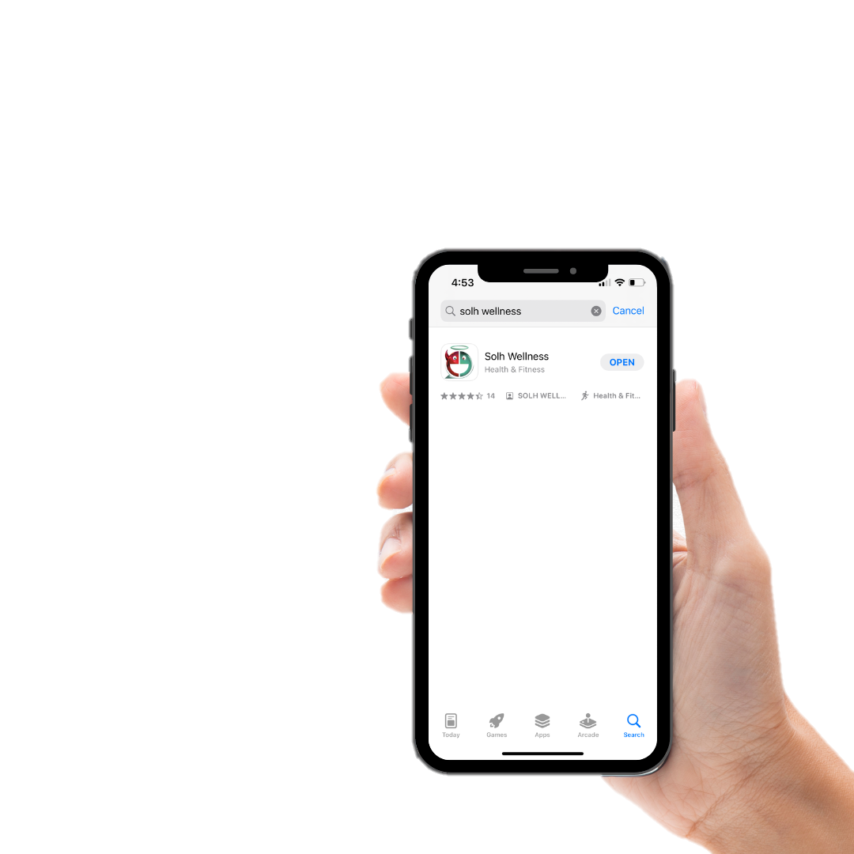
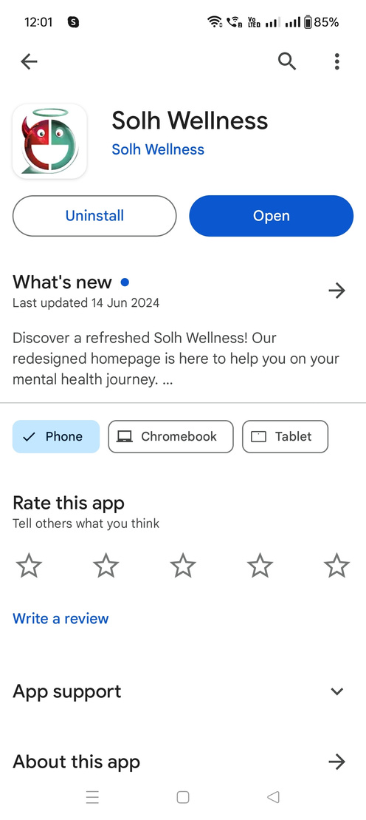
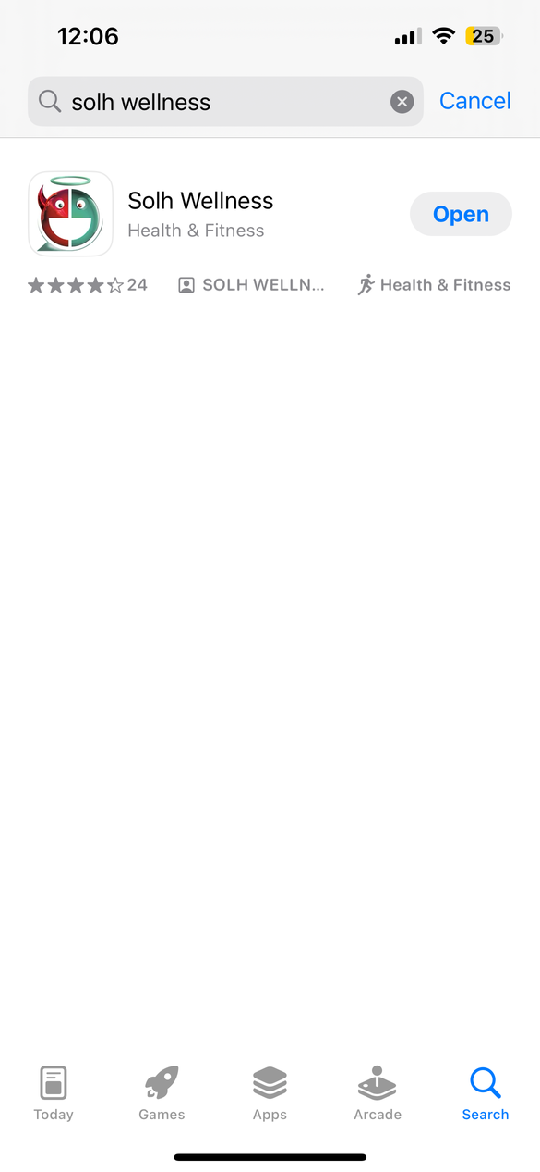
STEP 1
Go to the App store (iOS) or Play store (Android) and
download the Solh Wellness app
2

Slide 3
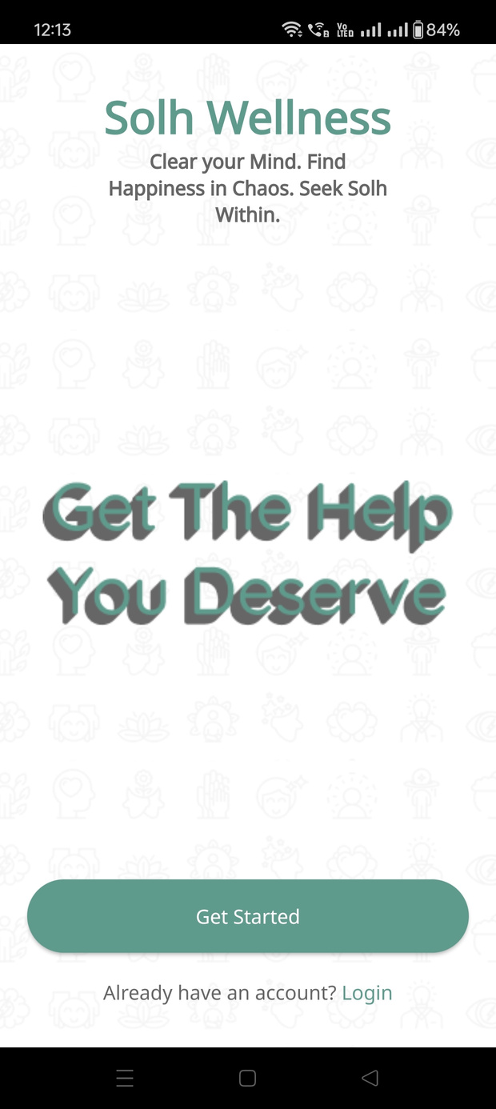
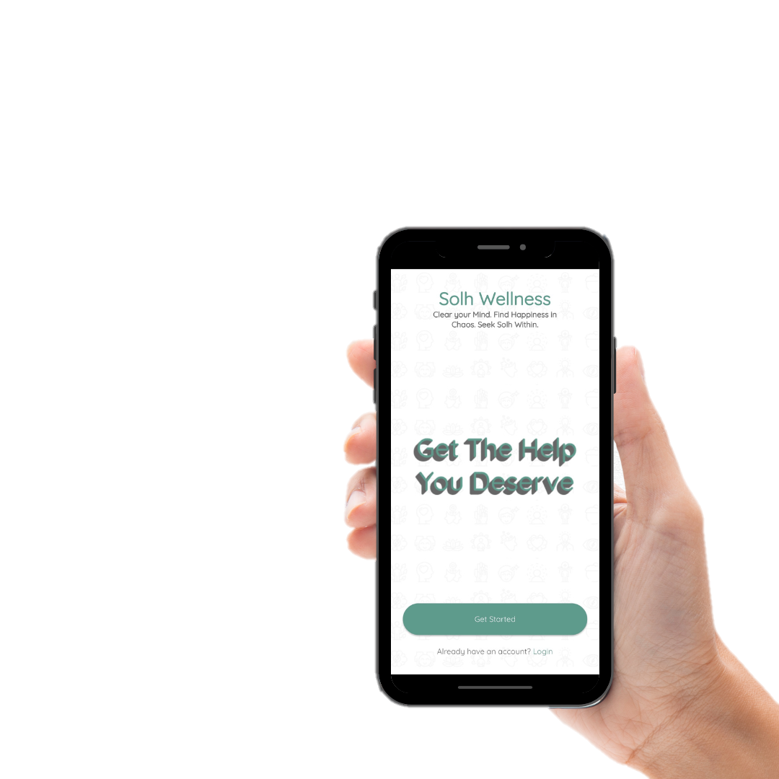
STEP 2
Open the app and click on ‘Get Started’
Login if you already have an account
OR
3

Slide 4
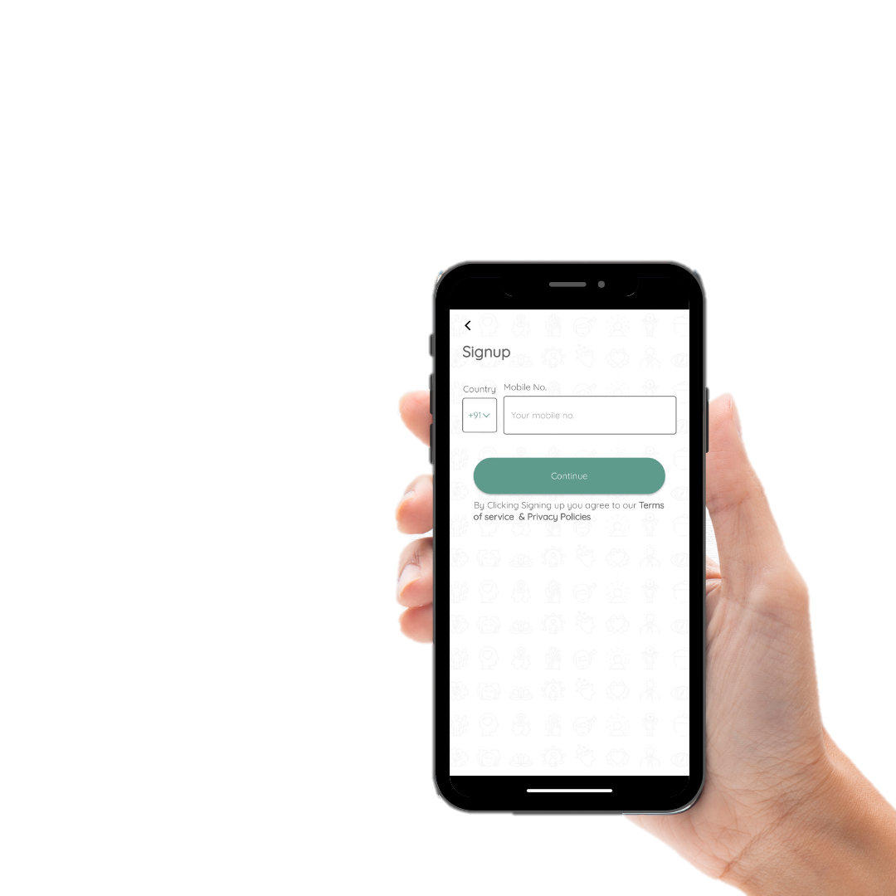
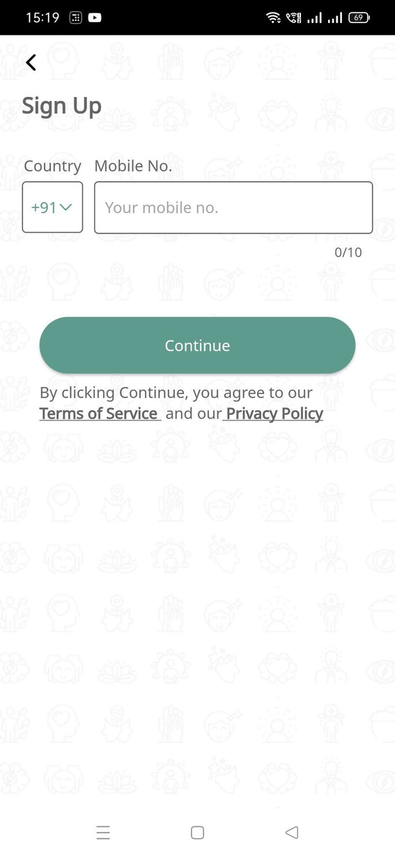

STEP 3
Enter your mobile number and complete OTP verification to complete logging in
4

Slide 5
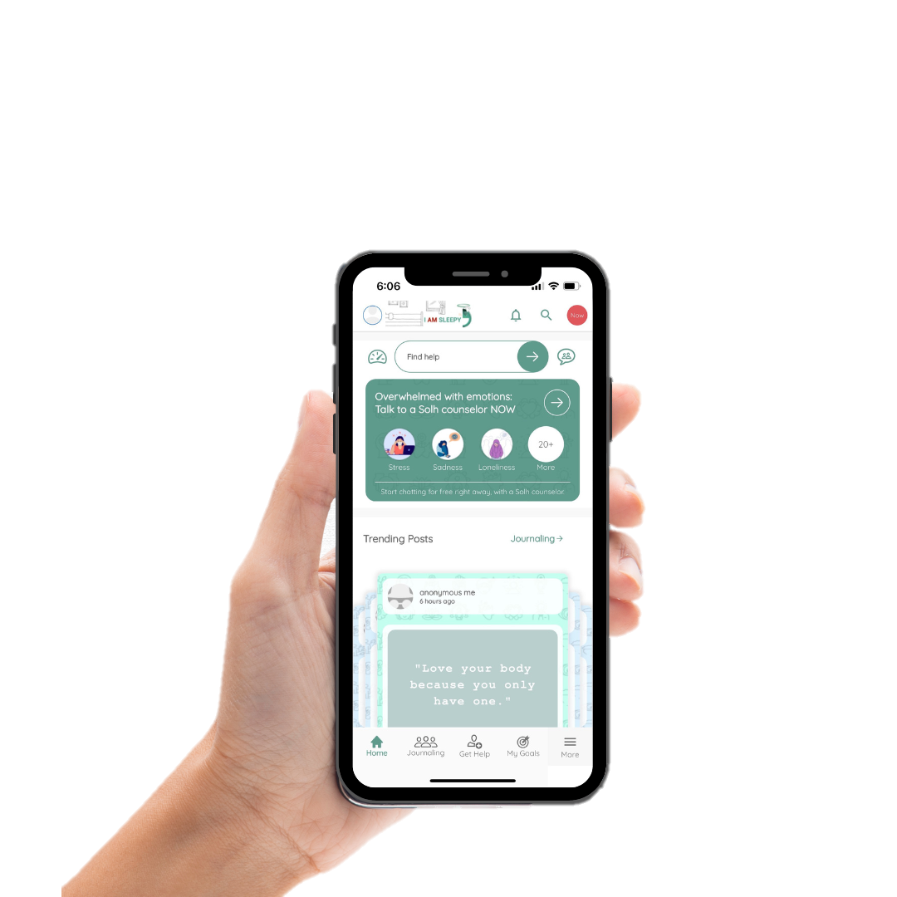
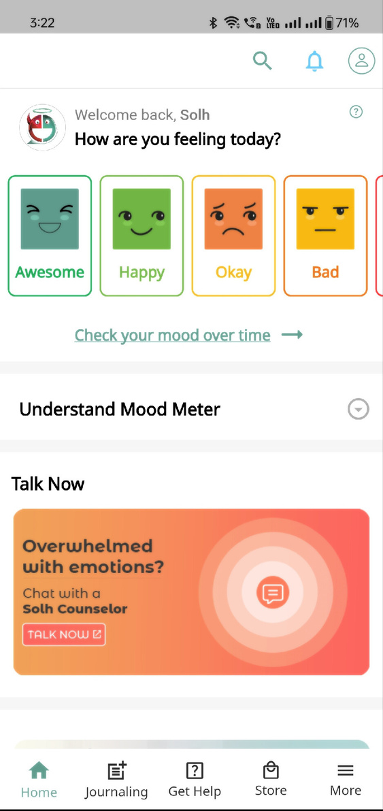

This is what your home screen will look like:
Mood meter
Determine your mood using the mood meter
Talk now
Instantly connect with a counselor whenever you feel overwhelmed

Slide 6
How To Join an Organization?
6

Slide 7
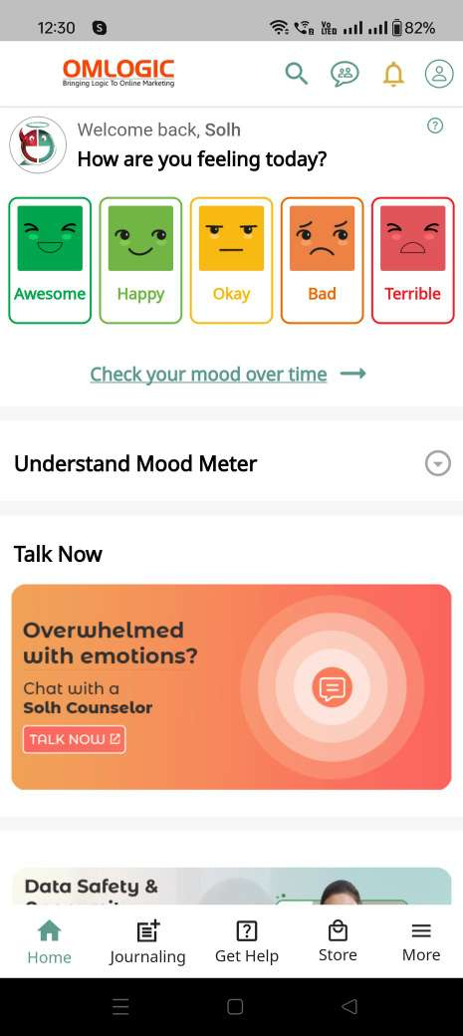

STEP 1
Click on ‘More’
7

Slide 8
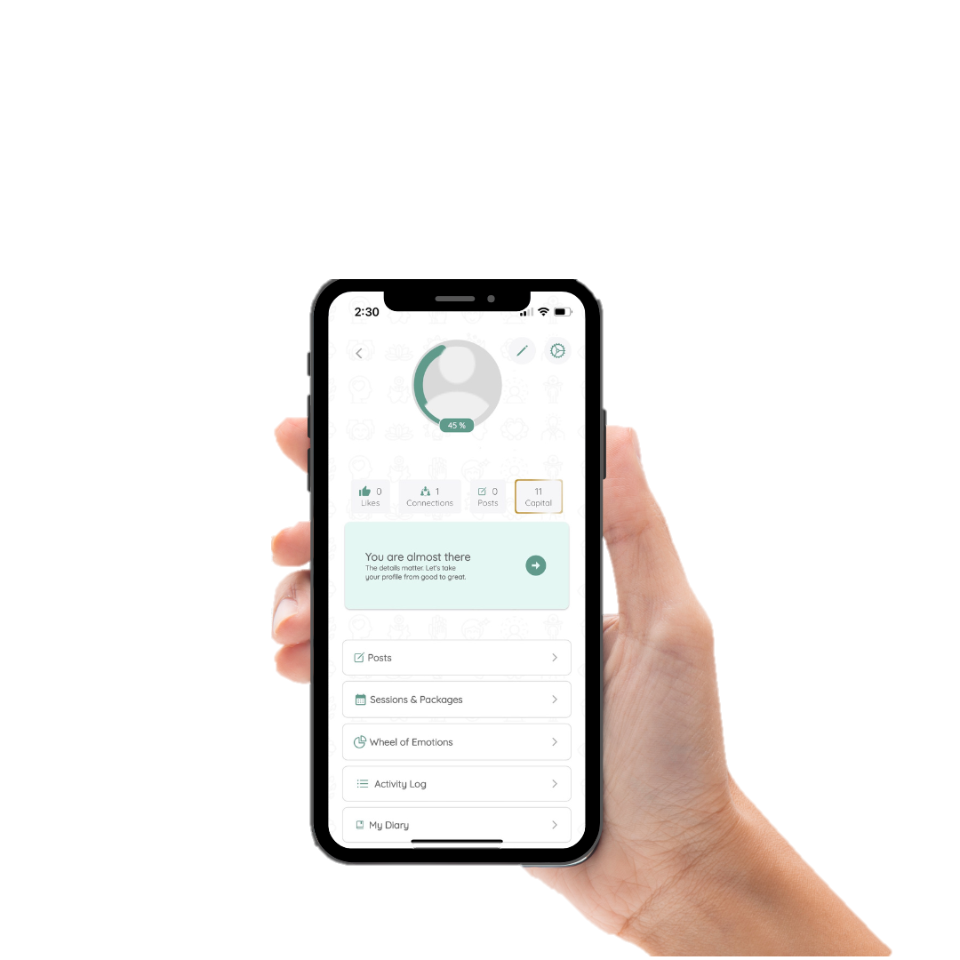
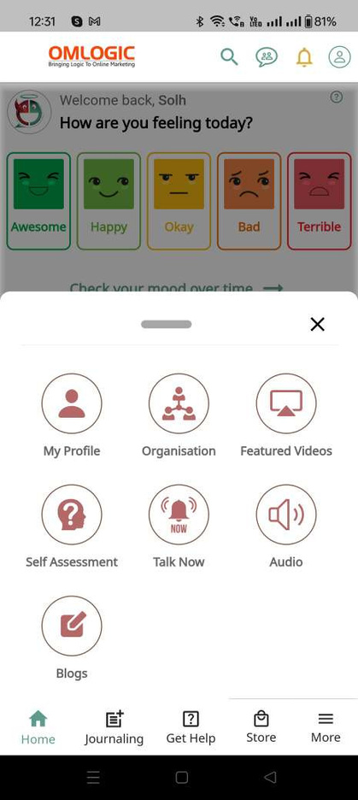
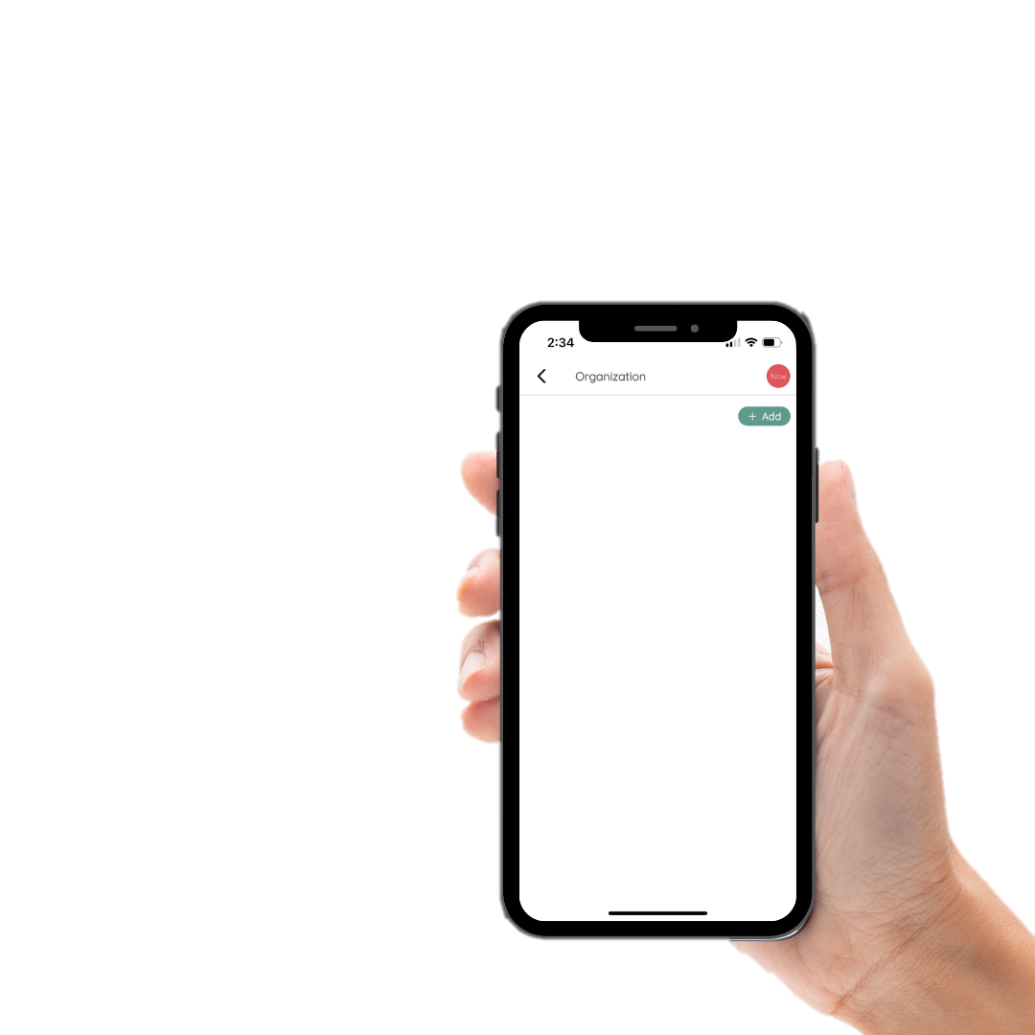

STEP 2
Click on ‘Organization’
STEP 3
Click on ‘Add’
8

Slide 9
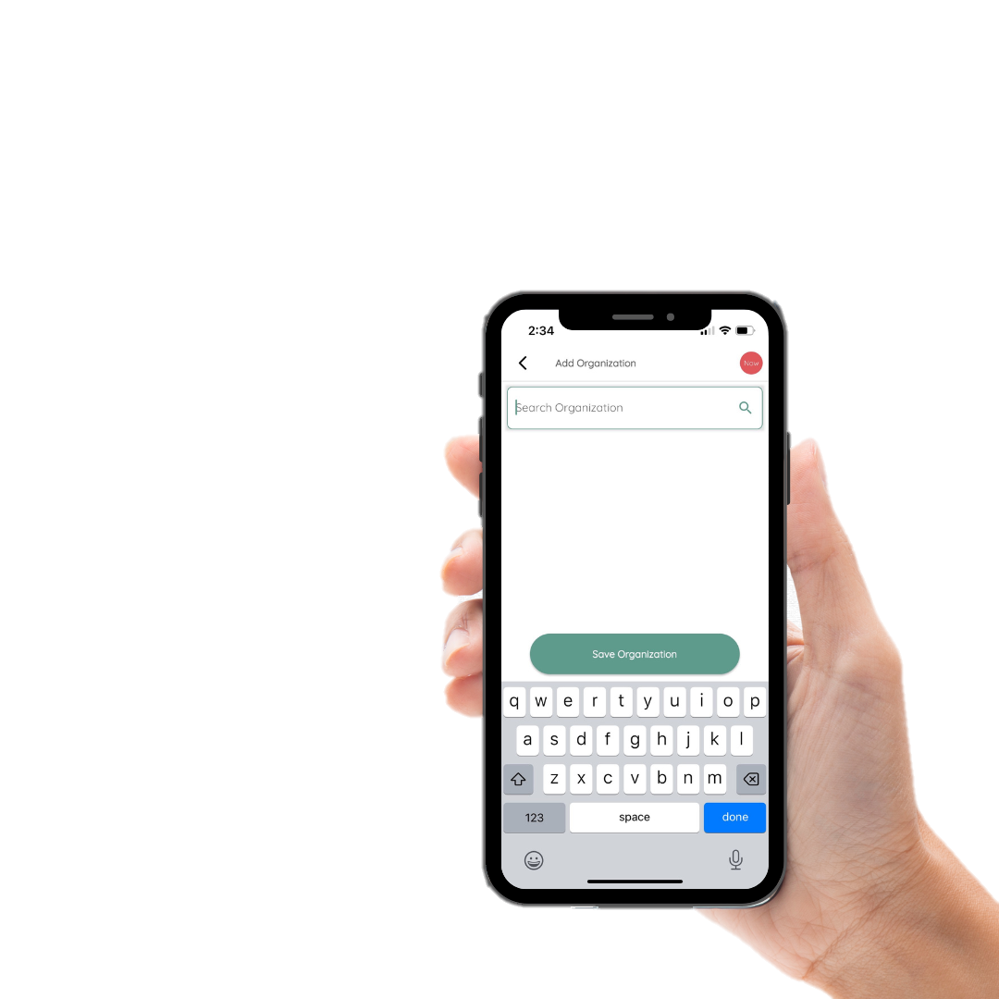
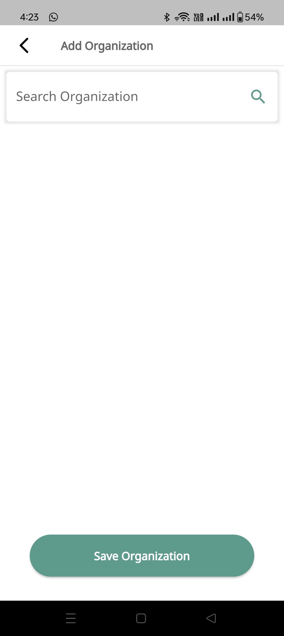
STEP 5
Enter your organization’s name
STEP 6
Once selected, click on ‘Save Organization’
10

Slide 10
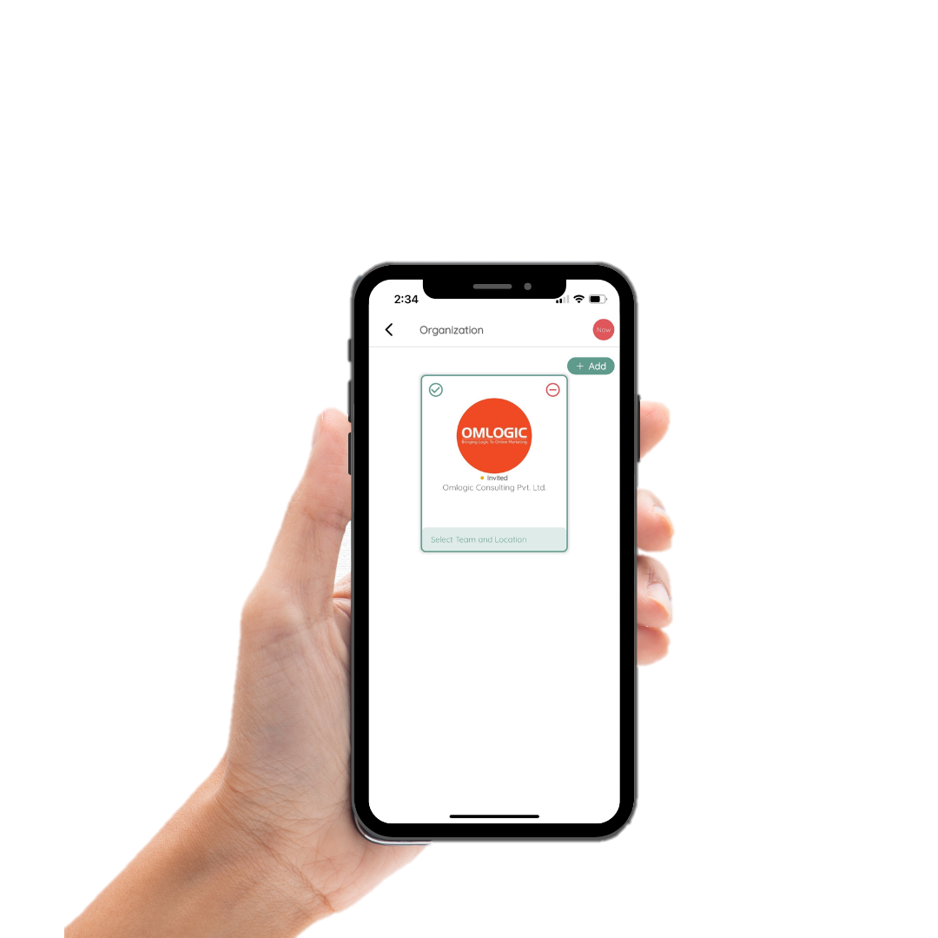
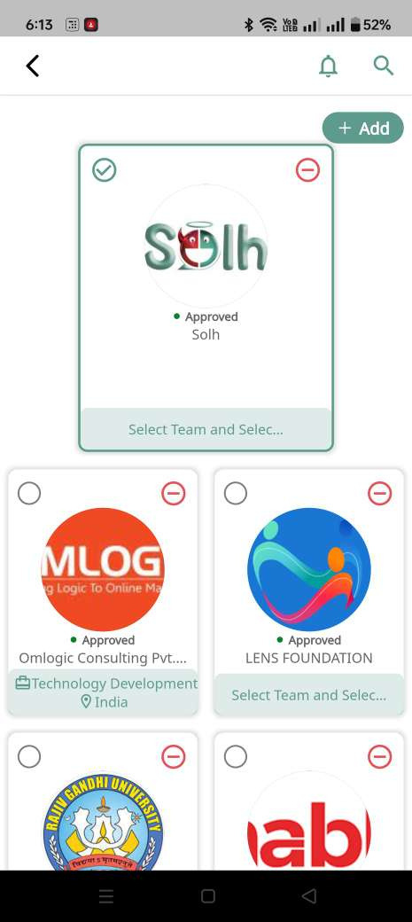
Once your request is approved, you will get access to all organization specific features!
11

Slide 11
Let’s explore what’s different when you join as an Organizational User

Slide 12
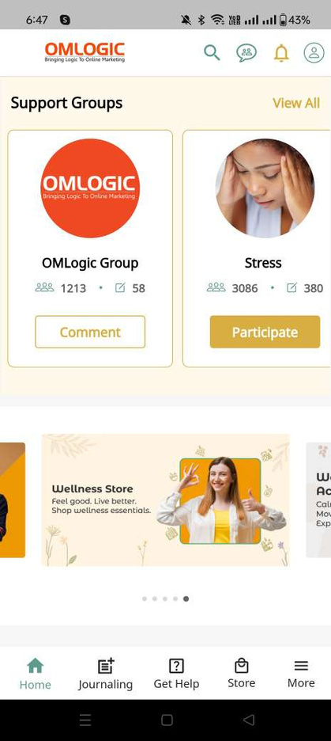
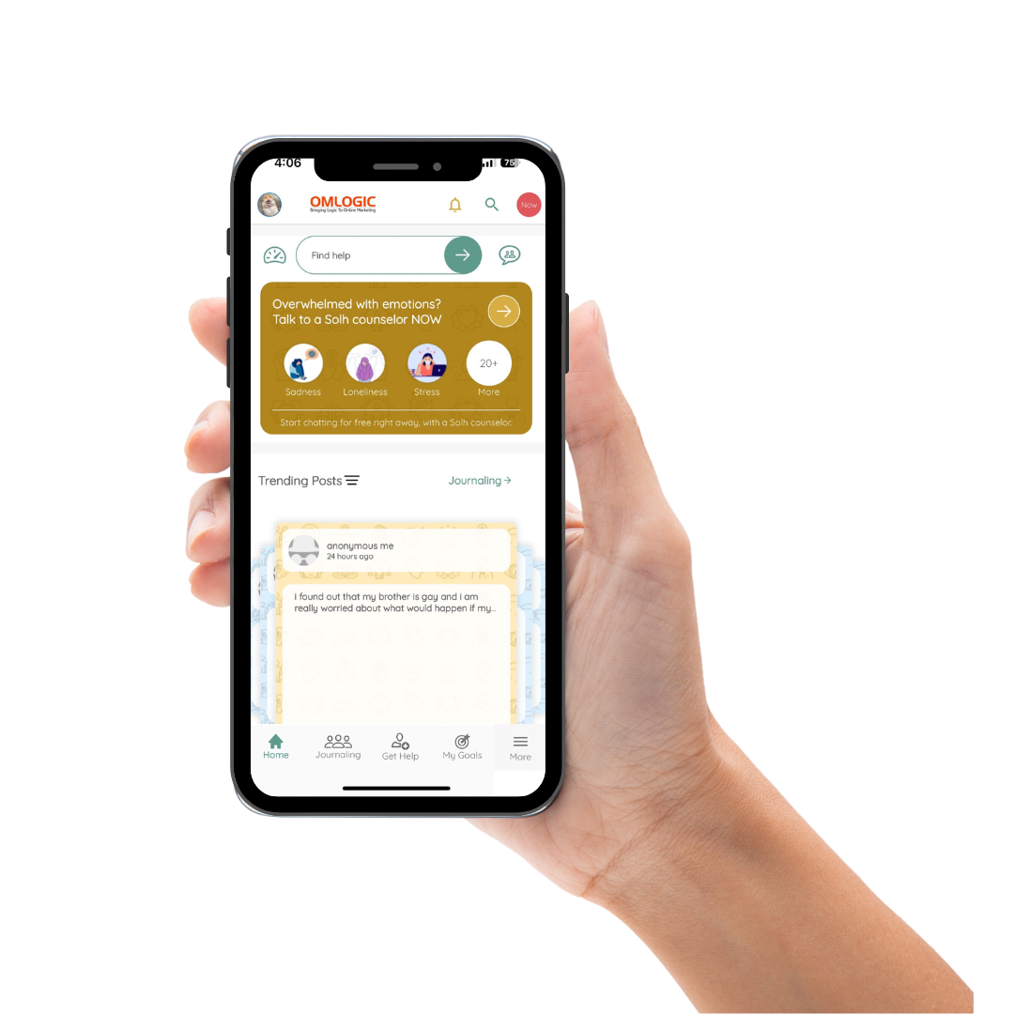

customized theme
Customized color theme for the organization and organization logo on top

Slide 13
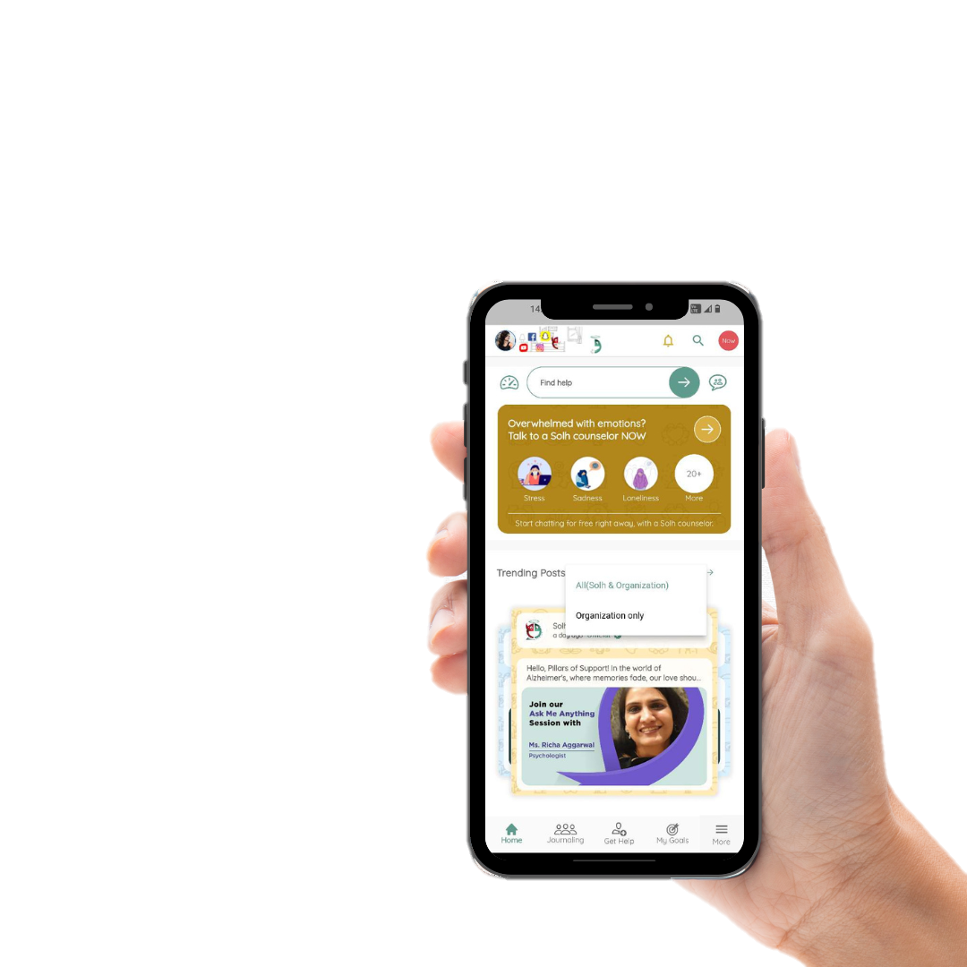
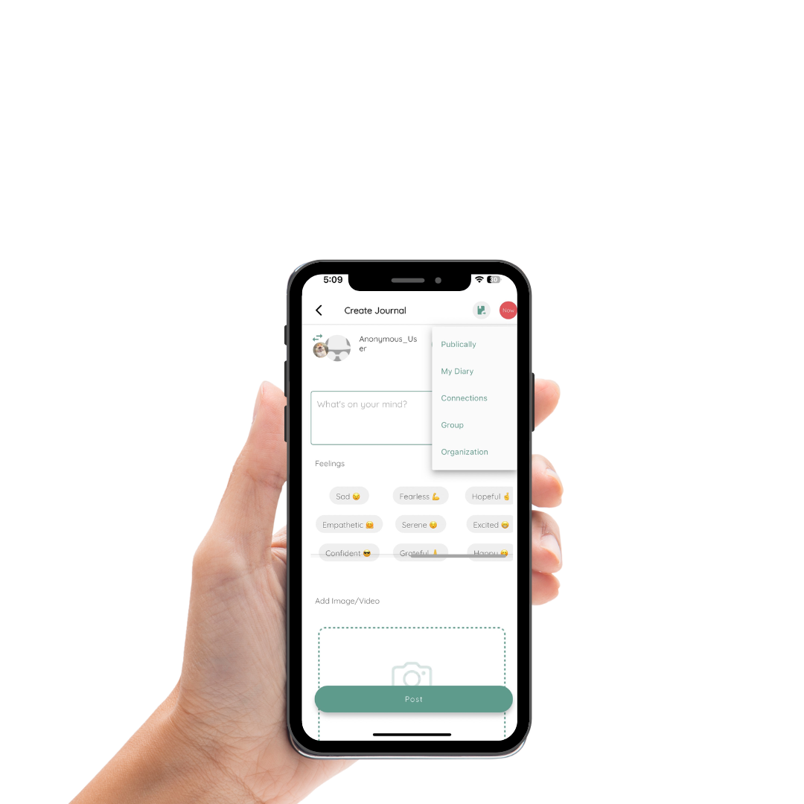
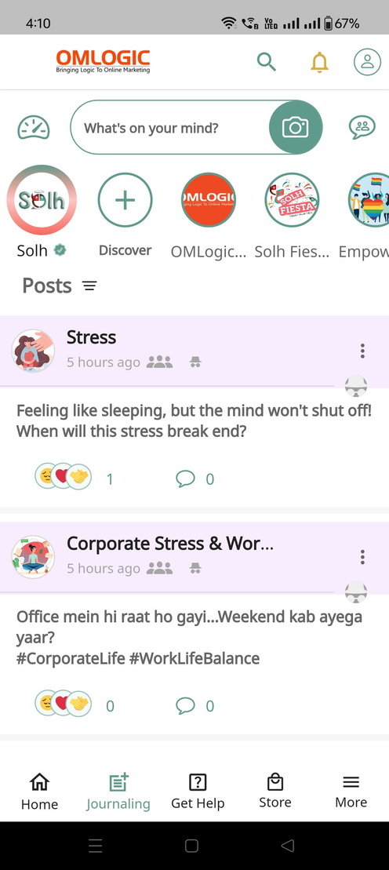
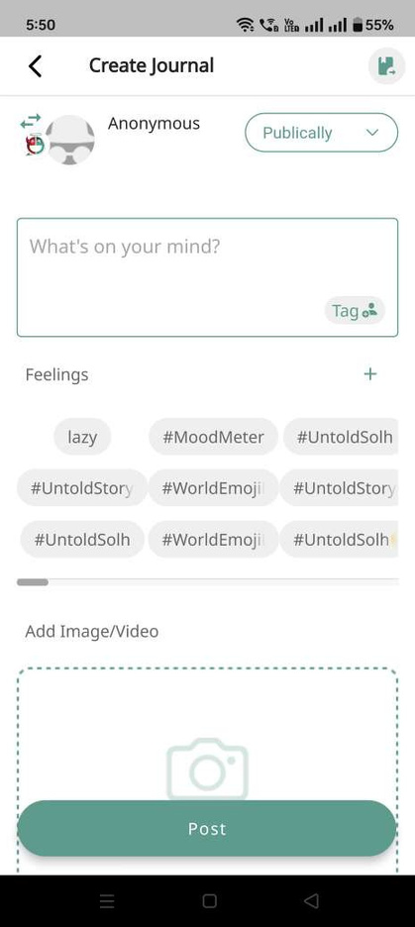
Journal within
organization
Option to post in the organization and view organization only or all posts

Slide 14
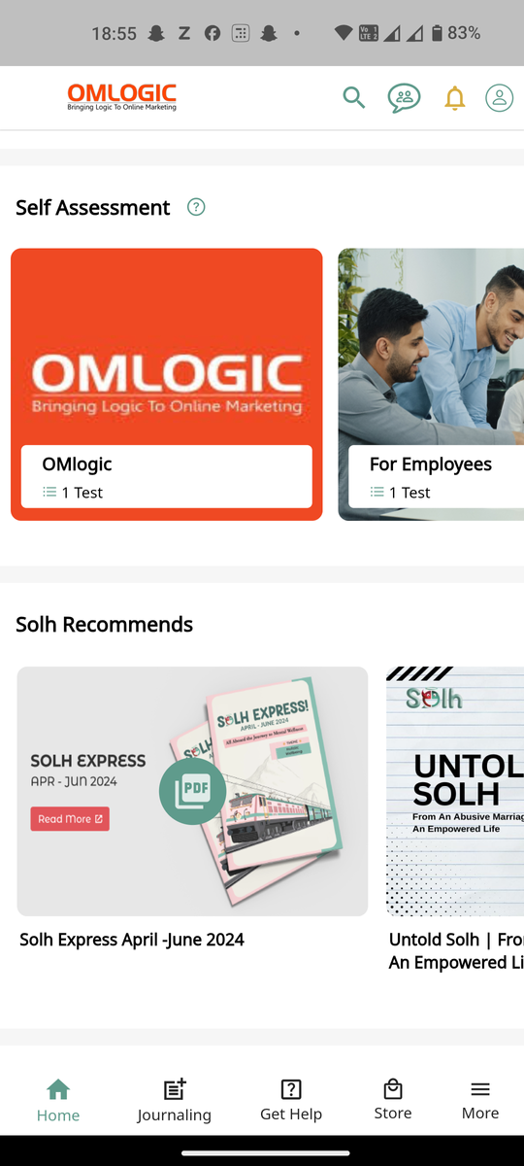
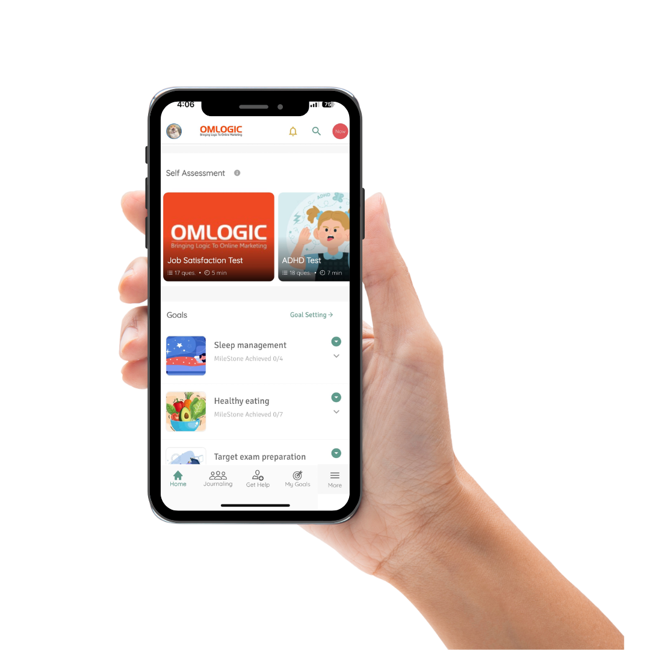

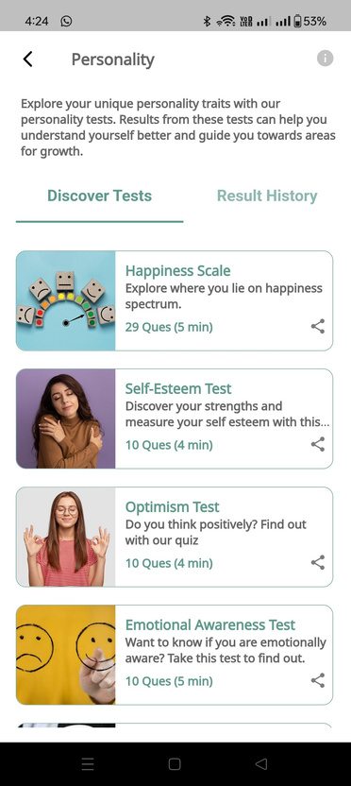
New self assessments
Self assessment tests curated specially for organizational users

Slide 15
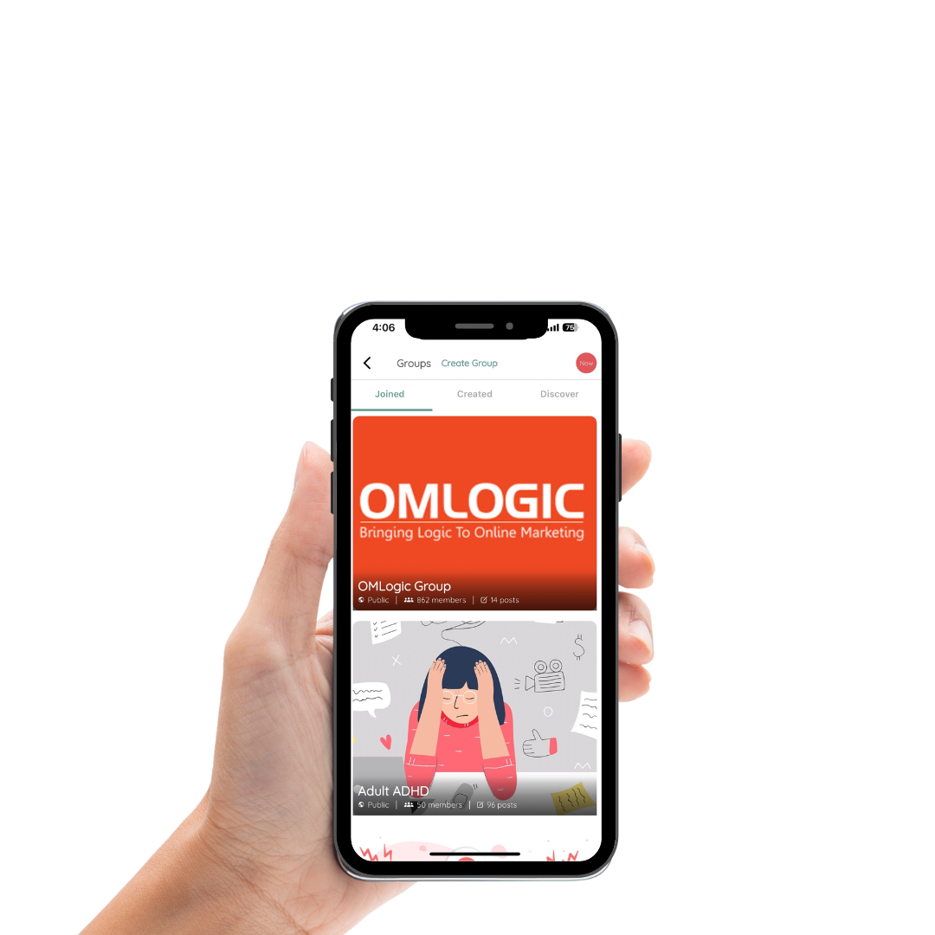
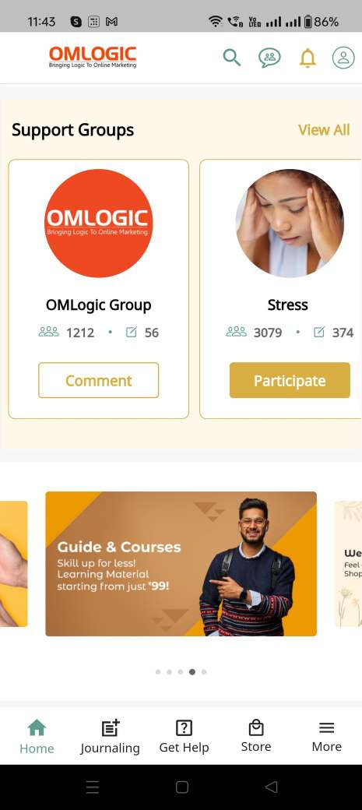
Organization support group
Custom support group exclusively for people enrolled in the organization

Slide 16
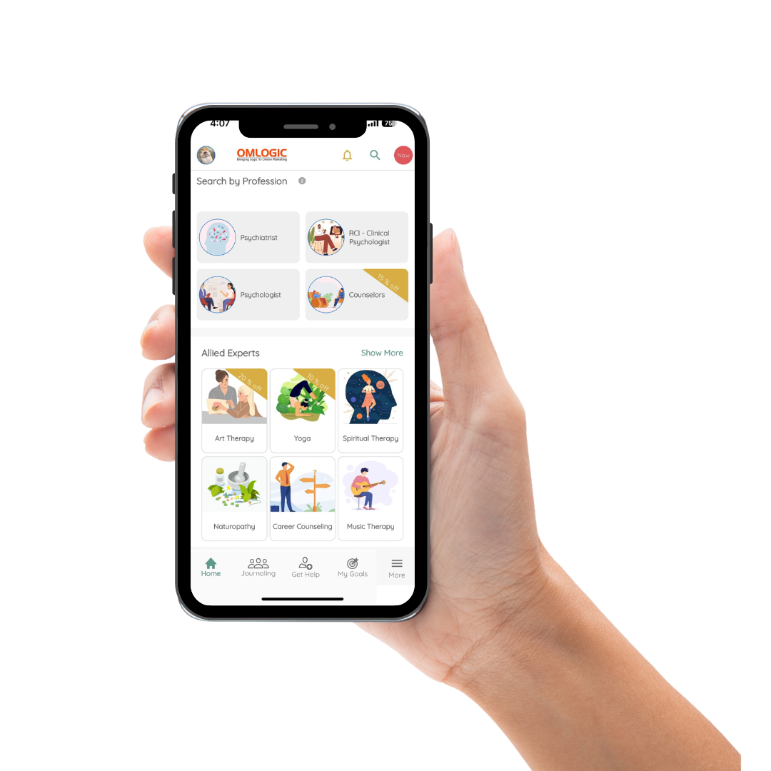
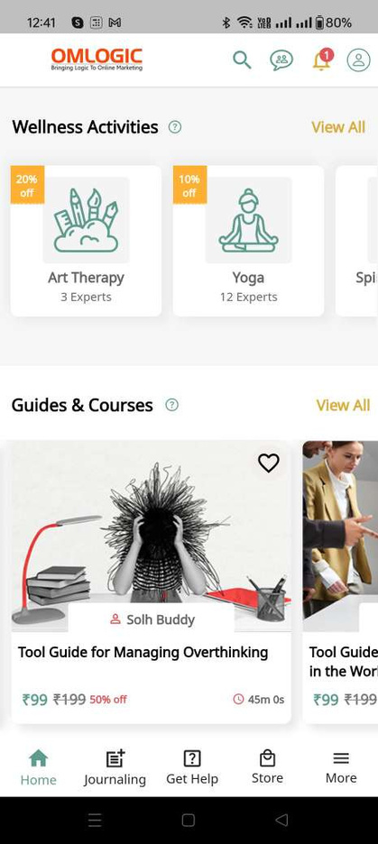
discounts and offers
Exclusive discounts for organizational users on Clinical and Allied Therapies

Slide 17
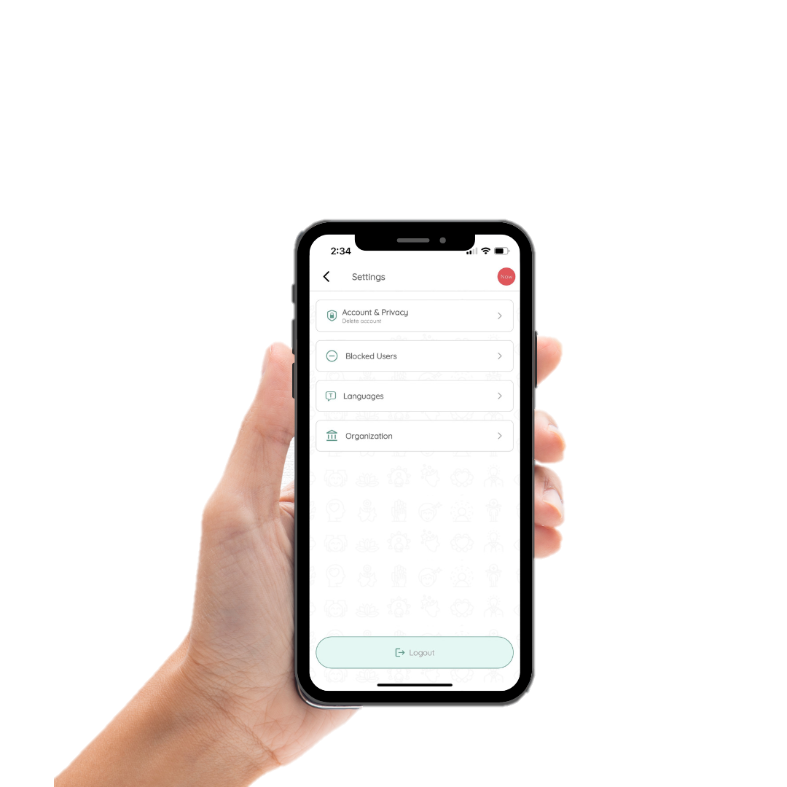
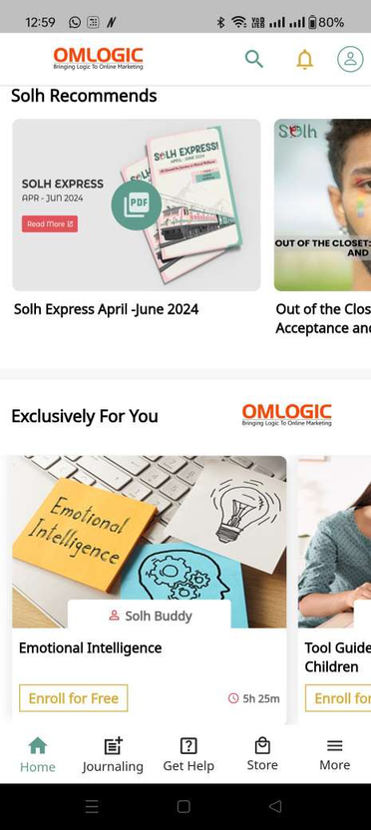
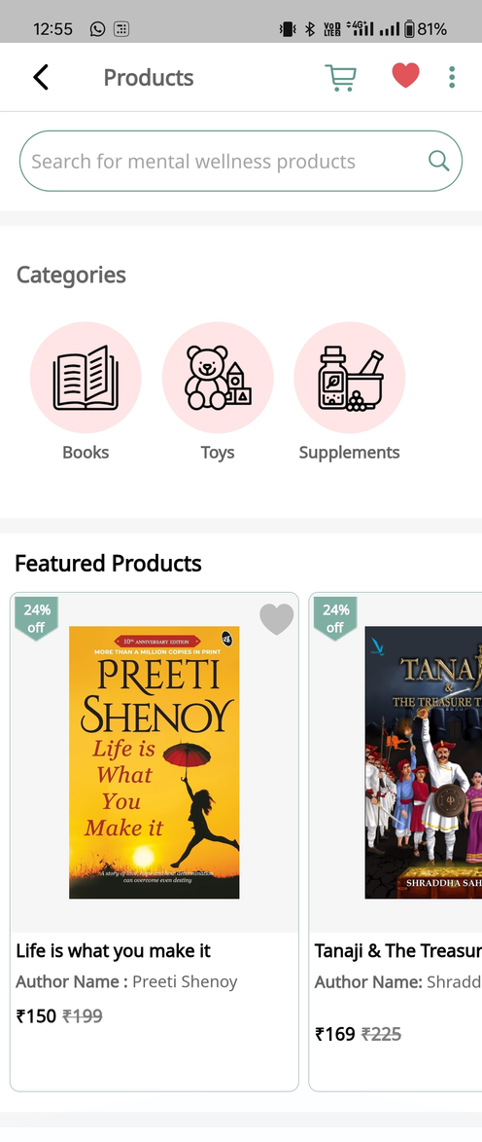

Exclusive Guides & Courses free for organizational users
Buy Books, Toys & Supplements through our Wellness Store for holistic well-being
9

Slide 18

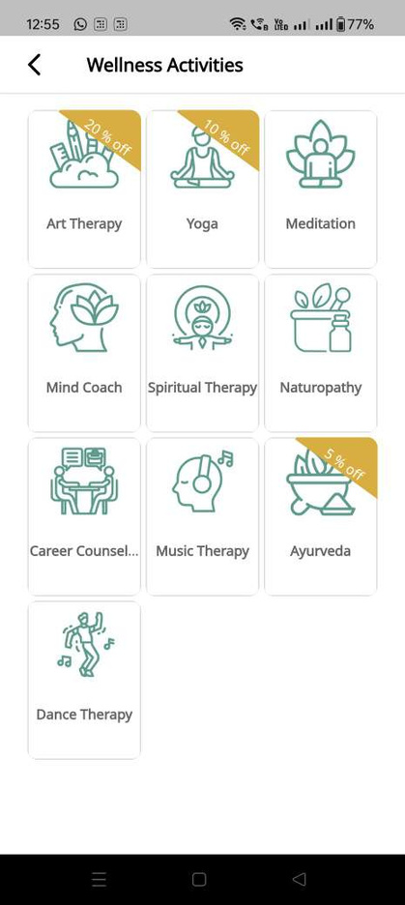
Get professional support from mental health experts, including clinical and allied therapists
9

Slide 19
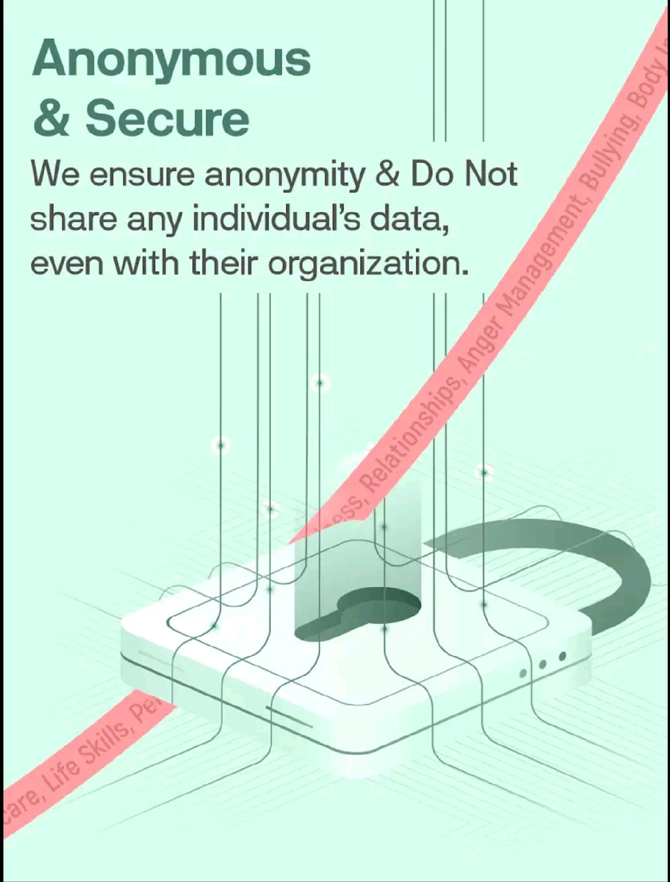
dATA SAFETY & ANONYMITY
Your privacy is our top priority. We guarantee complete data safety and anonymity, ensuring your details are never shared with anyone; including your organization!

Slide 20


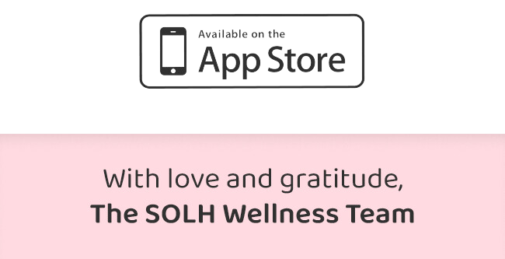
Take the first step towards better mental health and well-being.
Download the Solh App Now!

